Slide 1
iMAGE PROCESSING TECHNIQUES IN LOCALIZATION OF DFU
under guidance of:
prof.Vaibhavee jane
V kamal sowgandhik -190303105581
G P S V S Sairam -190303105400
G Prasanth - 190303105399

Slide 2
Index
Abstract
Introduction
Literature review
Existing Method
Disadvantages
Proposed method
Block Diagram
Advantages
Implementation
Modules
Algorithms
Architecture
Results
Conclusion
Future Scope
Hardware and Software Requirements
References

Slide 3
Abstract
Diabetic Foot Ulcer (DFU) is one of the major health concerns about Diabetes. These injuries impair the patient’s quality of life, bring high costs to public health, and can even lead to limb amputations. The use of automatic tools for detection can assists specialists in the prevention and treatment of the disease. Some methods to address this problem based on machine learning have recently been presented. This article proposes the use of deep learning techniques to assist the treatment of DFUs, more specifically, the detection of ulcers through photos taken from the patient’s feet.

Slide 4
introduction
Diabetes is a serious complication with a high long term impact on the population. The incidence of diabetes has grown globally in the last decades causing high health costs. It is among the top 10 causes of death in adults. Diabetic Foot Ulcer (DFU) is one of the major complications of Diabetes. The patients have a probability of 12-25% of developing DFU during their lifetime. This rate can reach 19-34% depending on the data used. Such ulcers have become a major problem in public health because of the increase in morbidities, decreased quality of life, and because the treatment is expensive. Due to inadequate conduct in the treatment of foot ulcers, there is a delay in the improvement of the injury and the possibility of lower limb amputation

Slide 5
LITERATURE SURVEY
SL NO | Journal type with year | Authors | Title | Outcomes
01 | VISAPP 2021 | Artur Leandro da Costa Oliveira Andre Britto de Carvalho and Daniel Oliveira Dantas | Faster R-CNN Approach for Diabetic Foot Ulcer Detection | In this work, we propose an automatic approach to detect DFUs using deep learning techniques. We have implemented an extended version of the Faster RCNN approach. We have adopted several strategies to achieve high precision in detecting ulcers, to decrease the number of false positives, and to speed up the detection time. We changed the numbers of regions, the anchor scales, used data augmentation in the dataset, and adopted a CNN that has better detection results than previous approaches
02 | arXiv,2021 | Moi Hoon Yap Ryo Hachiuma Azadeh Alavi and team | Deep Learning in Diabetic Foot Ulcers Detection: A Comprehensive Evaluation | We conduct a comprehensive evaluation of the performance of deep learning object detection networks for DFU detection. While the overall results show the potential of automatically localizing the ulcers, there are many false positives, and the networks struggle to discriminate ulcers from other skin condition
03 | 2022, MDPI | Khairul Munadi Khairun Saddami Maulisa Oktiana and team | A Deep Learning Method for Early Detection of Diabetic Foot Using Decision Fusion and Thermal Images | In this article, we proposed a novel framework to classify the thermal images of diabetic foot ulcers (DFU) based on the fusion schema of two CNN classification results. The CNNs used were MobileNetV2 and ShuffleNet
04 | ORIGINAL RESEARCH : February 2022 | Yi Xu, Kang Han, Yongming Zhou, , Jian Wu, , Xin Xie and and Wei Xiang | Classification of Diabetic Foot Ulcers Using Class Knowledge Banks | In this paper, we proposed the method called the class knowledge banks (CKBs) which can effectively extract class knowledge from the training data and explicitly leverage the class knowledge in the testing. The proposed method is an alternative means to produce the logits instead of the usual linear classifiers in the literature.

Slide 6
Existing method
In the existing there are methods implemented to classify Diabetic foot ulcer and normal foot in deep learning. In method we are performing the classification classify Diabetic foot ulcer and normal foot identification using Resnet, vgg19, vgg16 of deep learning along with the Machine learning methods. As image analysis based approaches for classification of Diabetic foot ulcer and normal foot.

Slide 7
disadvantages
Less accuracy.
More Losses.

Slide 8
PROPOSED SYSTEM
In purposed method we are performing the classification of either the image is Diabetic foot ulcer or normal foot identification using Convolution Neural Network (CNN) and Mobile net of deep learning along with the Machine learning methods. As image analysis based approaches for Diabetic foot ulcer and normal foot classification and authentication. Hence, proper classification is important for the Diabetic foot ulcer and normal foot that which will be possible by using our proposed method. Block diagram of proposed method is shown below.

Slide 9
Advantages:
Accurate classification
Less complexity
High performance
Easy Identification

Slide 10
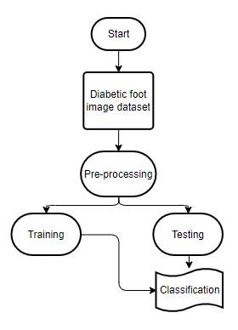
BLOCK DIAGRAM

Slide 11
IMPLEMENTATION
First we have taken the Diabetic foot Ulcer and normal foot images.
Load the dataset into and Preprocessing .
Here split the data in to train data and test data.
After splitting apply the CNN and Mobile net algorithm Respectively and fit the train data and test data.
We got the best accuracy score for MobileNet.
Later, the entire work is done with Django framework
User can view the home, about ,upload page and Results.

Slide 12
Modules
System
User
1. System:
1.1 Create Dataset:
The dataset containing images Diabetic foot Ulcer and normal foot images with the 2 classes which are to be classified is split into training and testing dataset with the test size of 30-20%.
1.2 Pre-processing:
Resizing and reshaping the images into appropriate format to train our model.
1.3 Training:
Use the pre-processed training dataset is used to train our model using CNN and Mobilenet algorithm.
1.4 Classification:
The results of our model is display of classified.

Slide 13
Modules
2. User:
2.1 Check accuracy
The user can check for the training accuracy of the model.
2.2 Upload Image
The user has to upload an image which needs to be classified.
2.3 View classified output
The classified image results are viewed by user.
2.4 View predicted diseases
The predicted diseases of classified images are viewed by user.

Slide 14
ALGORITHM
CNN:
In deep learning, a convolutional neural network (CNN/ConvNet) is a class of Deep neural networks most commonly applied to analyze visual imagery. Now when we think of a neural network we think about matrix multiplications but that is not the case with ConvNet. It uses a special technique called Convolution. Now in mathematics convolution is a mathematical operation on two functions that produces a third function that expresses how the shape of one is modified by the other.

Slide 15
ALGORITHM
Mobile Net:
MobileNet is an efficient and portable CNN architecture that is used in real world applications. Mobile Nets primarily use depth wise separable convolutions in place of the standard convolutions used in earlier architectures to build lighter models.MobileNets introduce two new global hyper parameters(width multiplier and resolution multiplier) that allow model developers to trade off latency or accuracy for speed and low size depending on their requirements.

Slide 16
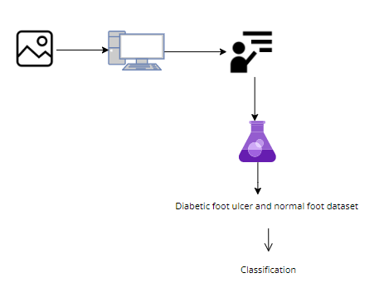
ARCHITECTURE

Slide 17
Results
In this application, we have considered the dataset Diabetic foot ulcer and normal foot trained using CNN and Mobile net algorithm along with Deep learning and ANN machine learning methods.
In the testing the image is uploaded and the image is classified.

Slide 18


Results and discussion
Home page

Slide 19
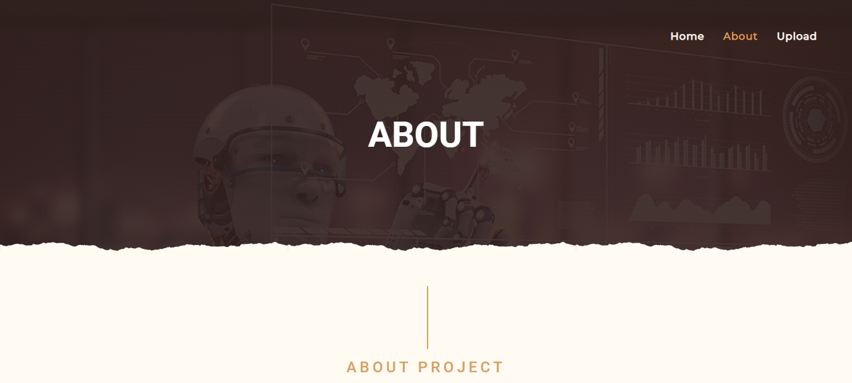
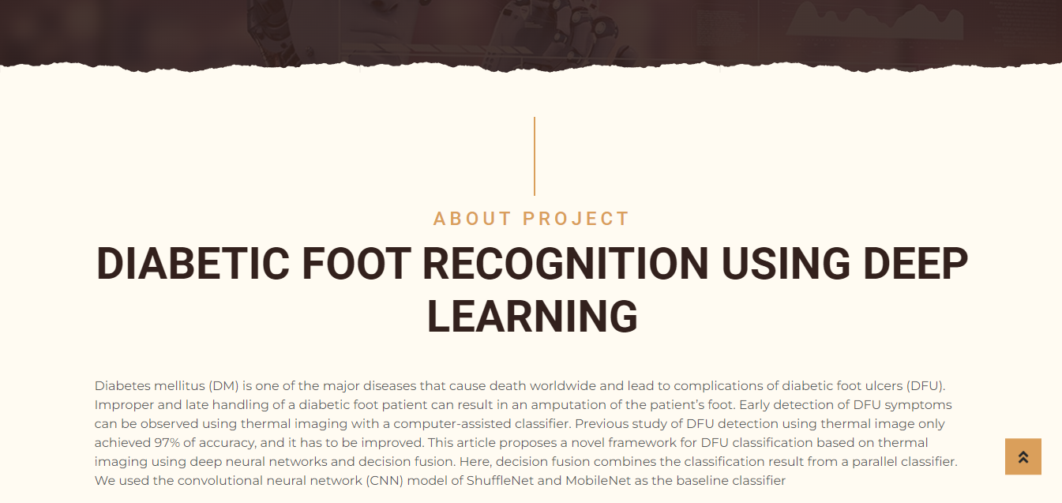
About

Slide 20
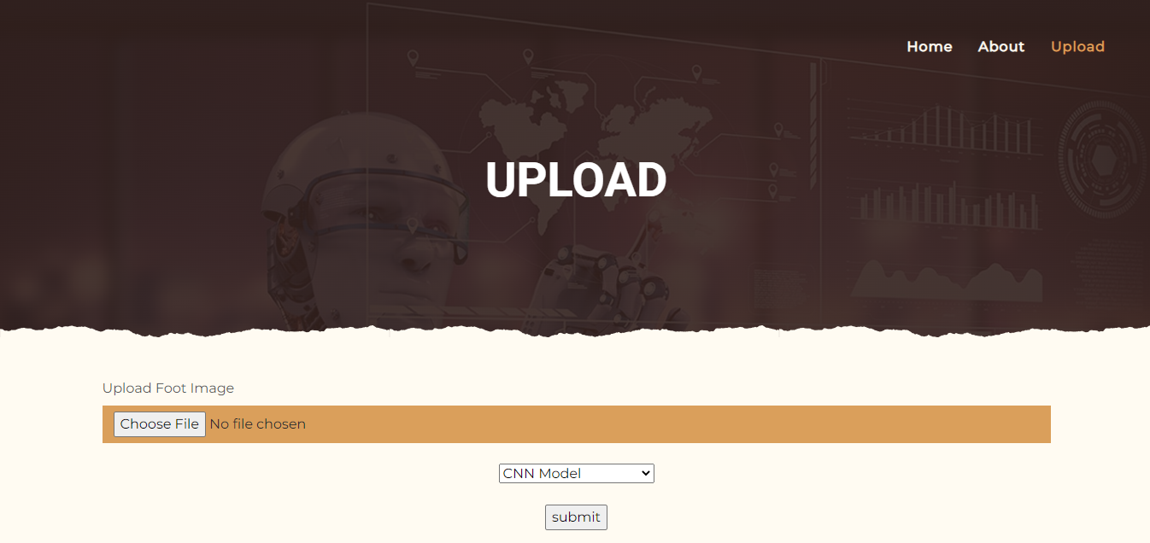
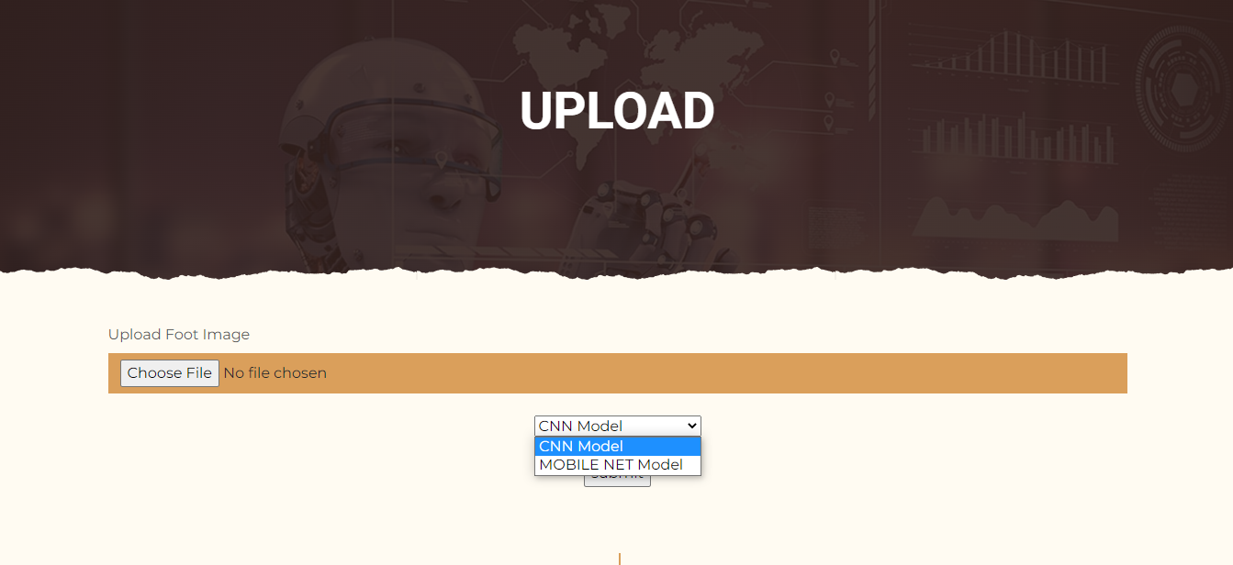
Upload and model selection

Slide 21
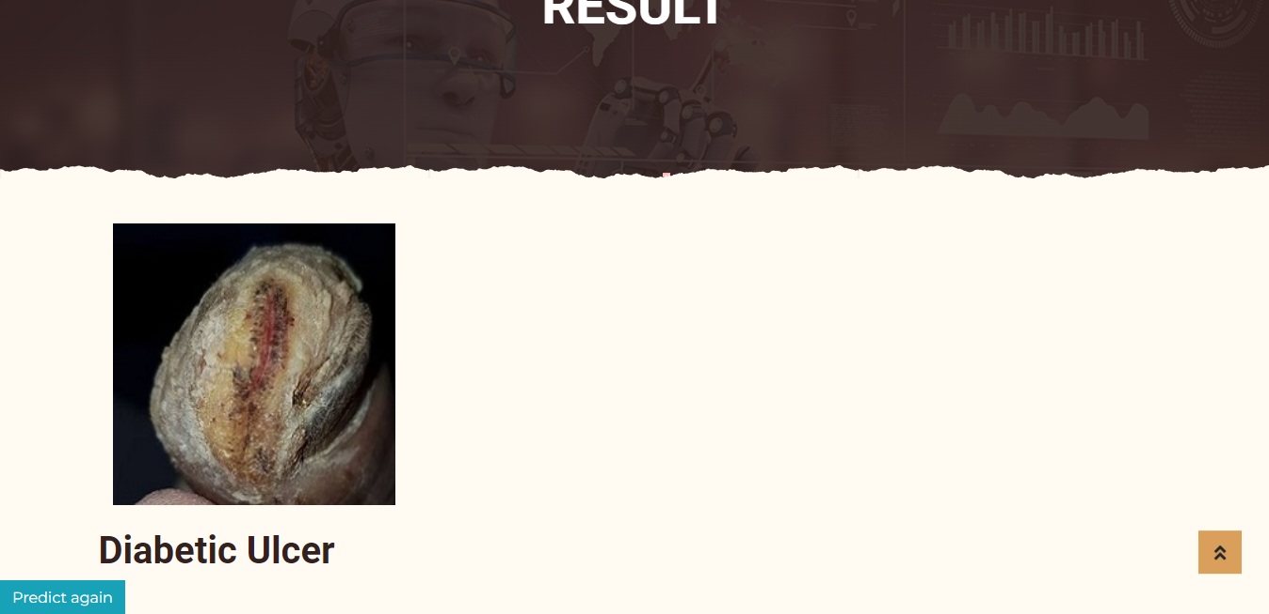
Result

Slide 22
CONCLUSION
In this project we have successfully classified the images of Diabetic foot ulcer and normal foot , are either matching with each other using the deep learning and Transfer learning. Here, we have considered the dataset of Diabetic foot ulcer and normal foot which will be of different types trained using CNN and Mobile net, transfer learning method. After the training we have tested by uploading the image and classified

Slide 23
FUTURE SCOPE
This can be utilized in future to classify and detect the different types of ulcers and make a difference in identifying and early treatment.This can be utilized in future to classify and detect the different types of ulcers andmake a difference in identifying and early treatment In this work, we trained variousclassifiers based on traditional machine learning algorithms, CNNs and proposed anew CNN architecture, mobileNet on DFU classification which discriminates theDFU skin from healthy skin. With high-performance measures in classification,mobile net allows theaccurate automated detection of DFU in foot images andmakeit an innovative technique for DFU evaluation and medical treatment. Forthe detection of DFU, it is very important to understand the difference betweenDFU and healthy skin to know the features differences between these two classesin computer vision perspective.

Slide 24
HARDWARE AND SOFTWARE REQUIREMENTS
H/W Specifications:
Processor : I5/Intel Processor
RAM : 8GB (min)
Hard Disk : 128 GB
S/W Specifications:
Operating System : Windows 10
Server-side Script : Python 3.6
IDE : PyCharm, Jupyter notebook
Libraries Used : Numpy, IO, OS, Flask, Keras, pandas, tensorflow

Slide 25
references
D.G. Armstrong, A.J. Boulton, S.A. Bus, Diabetic foot ulcers and their recurrence, N. Engl. J. Med. 376 (2017) 2367–2375, https://doi.org/10.1056/nejmra1615439
R. Brown, B. Ploderer, L.S. Da Seng, P. Lazzarini, J. van Netten, MyFootCare: a mobile self-tracking tool to promote self-care amongst people with diabetic foot ulcers, in: Proceedings of the 29th Australian Conference on Computer-Human Interaction (OzCHI’17), Association for Computing Machinery, 2017, pp. 462–466, https://doi.org/10.1145/3152771.3156158.
T.Y. Lin, M. Maire, S. Belongie, J. Hays, P. Perona, D. Ramanan, P. Doll´ ar, C. L. Zitnick, Microsoft COCO: common objects in context, in: European Conference on Computer Vision (ECCV) 2014, Springer International Publishing, 2014, pp. 740–755, https://doi.org/10.1007/978-3-319-10602-1_48.
Y. Cao, K. Chen, C.C. Loy, D. Lin, Prime sample attention in object detection, in: 2020 IEEE/CVF Conference on Computer Vision and Pattern Recognition (CVPR), IEEE, 2020, pp. 11580–11588, https://doi.org/10.1109/cvpr42600.2020.01160.
K. He, X. Zhang, S. Ren, J. Sun, Spatial pyramid pooling in deep convolutional networks for visual recognition, IEEE Trans. Pattern Anal. Mach. Intell. 37 (2015) 1904–1916, https://doi.org/10.1109/tpami.2015.2389824

Slide 26
Thank you

